Slide 1
COMPOSITION OF FUNCTIONS
What is a composite function?
If we are given two functions, we can create another function by composing one function into the other. Such Functions are called composite functions.
A composite function is generally a function that is written inside another function. Composition of a function is done by substituting one function into another function.
f [g (x)] is the composite function of f (x) and g (x). The composite function f [g (x)] is read as “f of g of x”. The function g (x) is called an inner function and the function f (x) is called an outer function. Hence, we can also read f [g (x)] as “the function g is the inner function of the outer function f”.

Slide 2
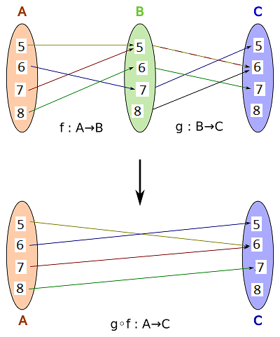
How to solve composite functions?
We use a small circle (∘) for the composition of a function. Here are the steps on how to solve a composite function:
Rewrite the composition in a different form. For example:
(f ∘ g) (x) = f [g (x)], (f ∘ g) (x²) = f [g (x²)]
Substitute the variable x that is in the outside function with the inside function.
Simplify the function.
NOTE: The order in the composition of a function is important because (f ∘ g) (x) is NOT the same as (g ∘ f) (x).
In f[g(x)] the range of g(x) must be a subset of f’s domain.

Slide 3
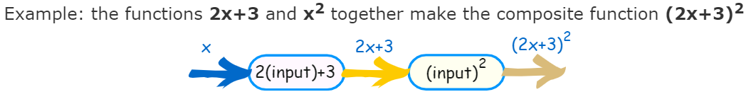
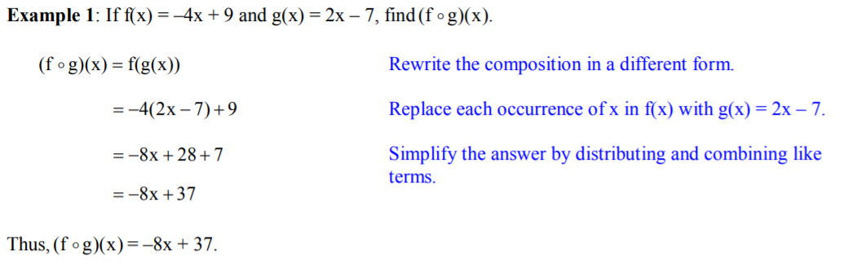
EXAMPLES

Slide 4
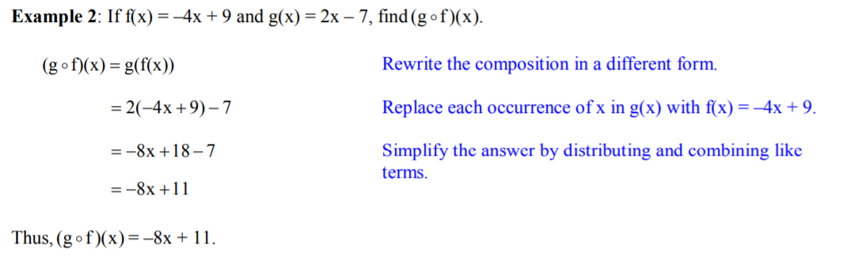
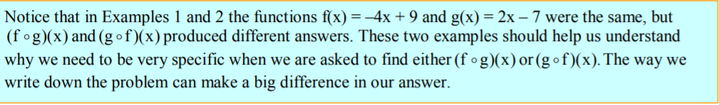
EXAMPLES

Slide 5
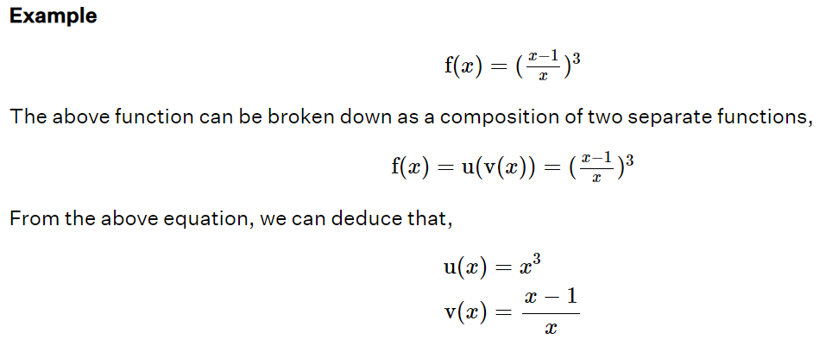
Breaking functions into composite of other functions
We can break a function into the composition of other functions. Let us see how this can be done using an example.

